Slide 1
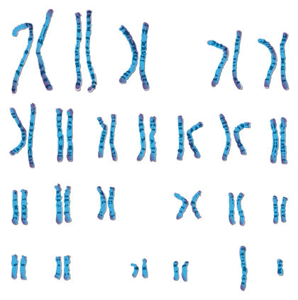
Introducing PCADMIX
MODELLING GENETIC ADMIXTURE
USING PCA COORDINATES with PYTHON
& CVXOPT

Slide 2
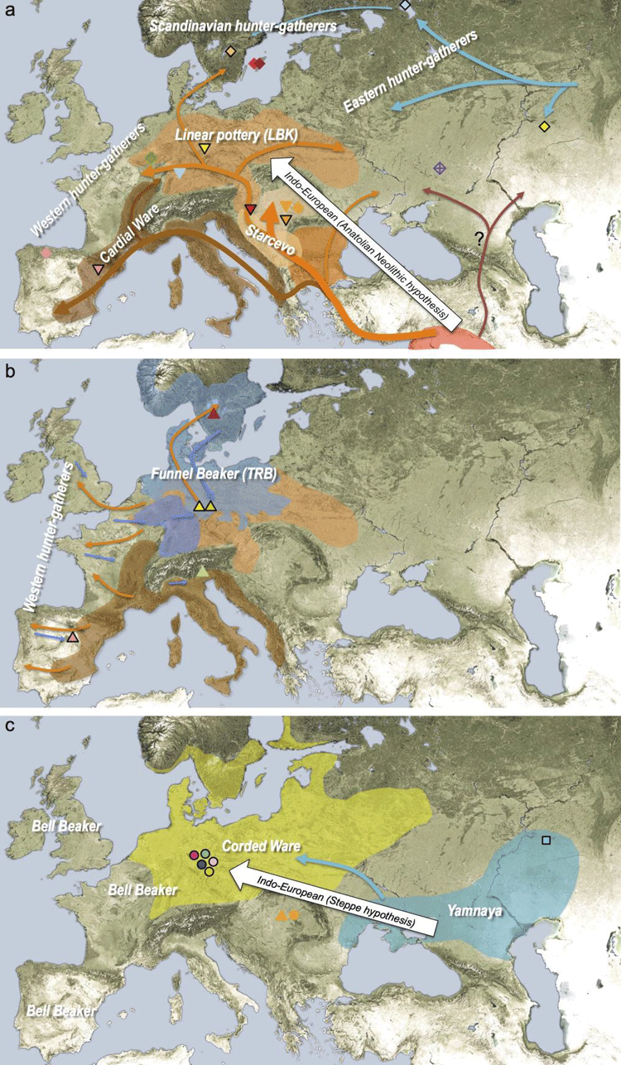


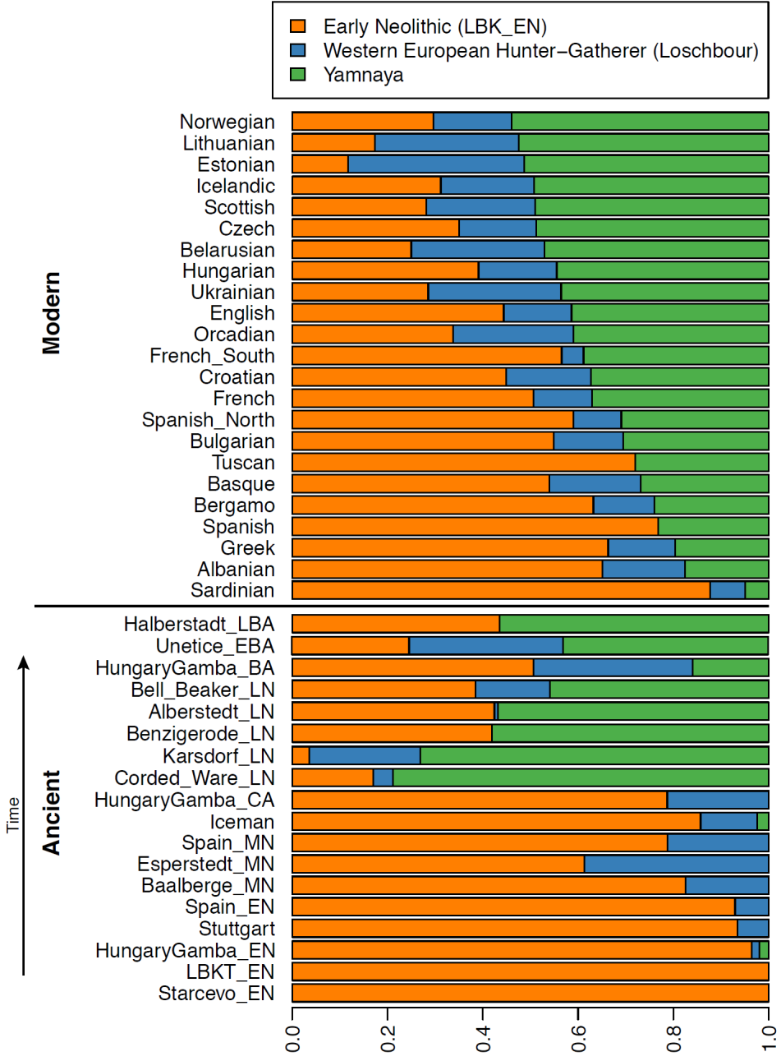
THE aDNA REVOLUTION

Slide 3
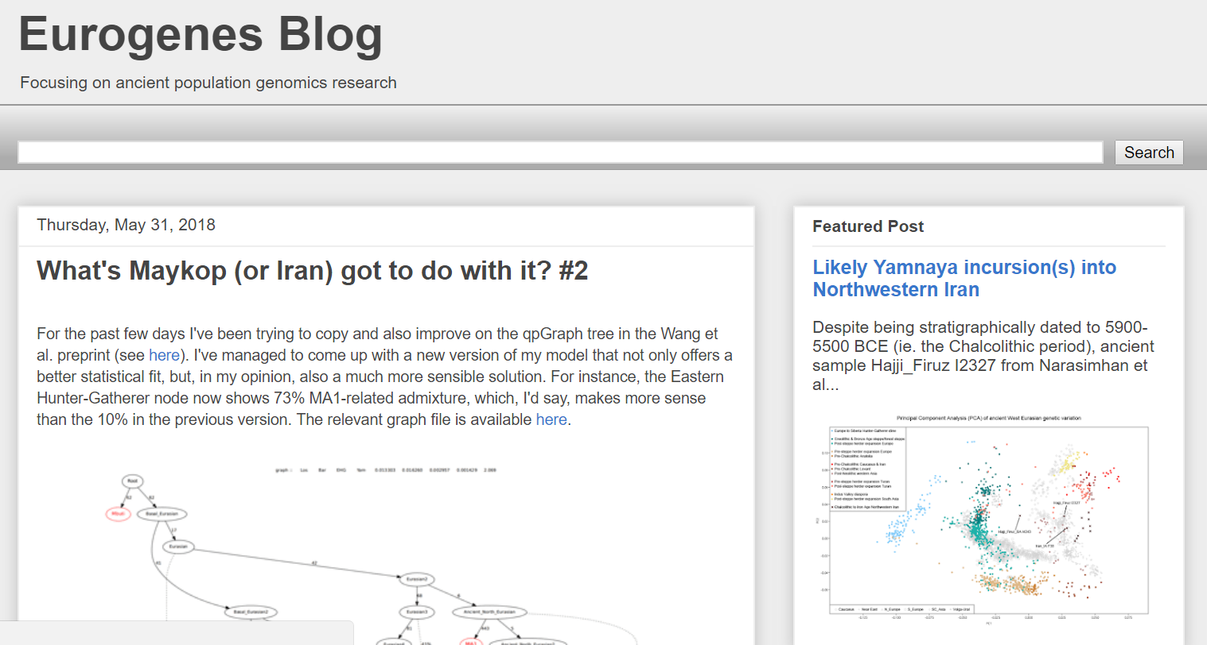


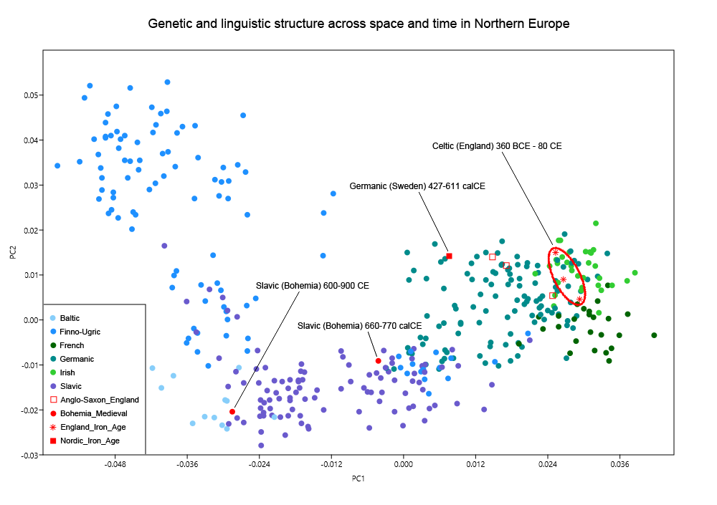
THE ROLE OF AMATEURS

Slide 4
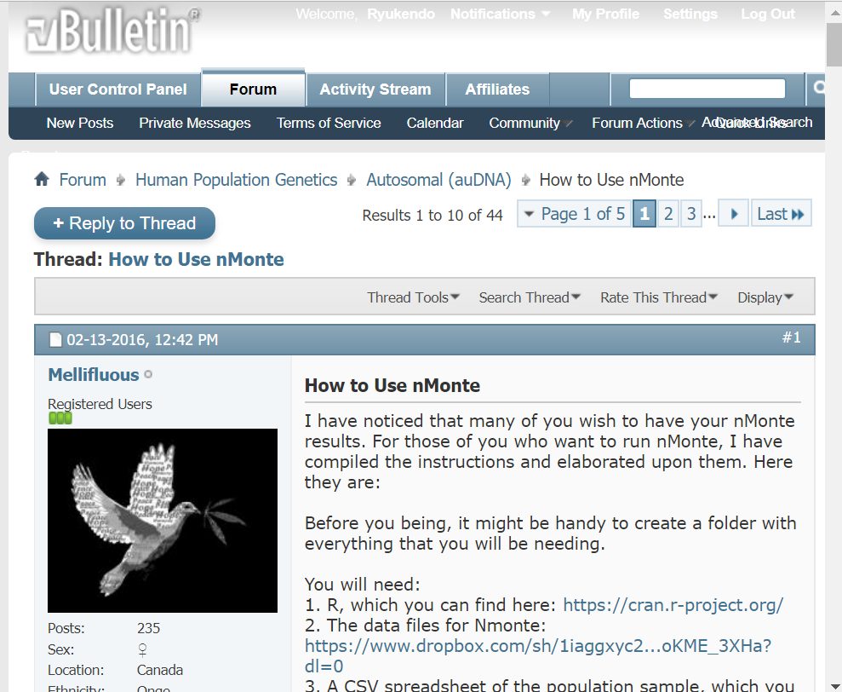
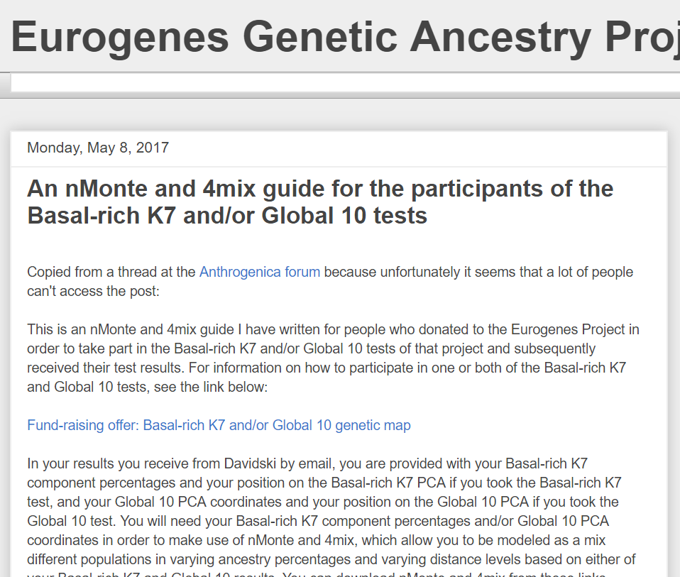
‘nMonte.R’
Lithuanian:lithuania3
"Motala_HG:I0012" 28.7 "Kotias:KK1" 26.7 "Loschbour:Loschbour" 20.75 "Anatolia_Neolithic:I1579" 19.2 "Samara_HG:I0124" 4.65 "Nganasan:ADR00504" 0 "Paniya:PNYD9" 0 "Yoruba:HGDP00928" 0 distance_abs=0.025956 / distance_euc=0.006227

Slide 5
‘nMonte.R’
Slow and computationally inefficient
Minutes for one run
Monte Carlo method
Not robust

Slide 6
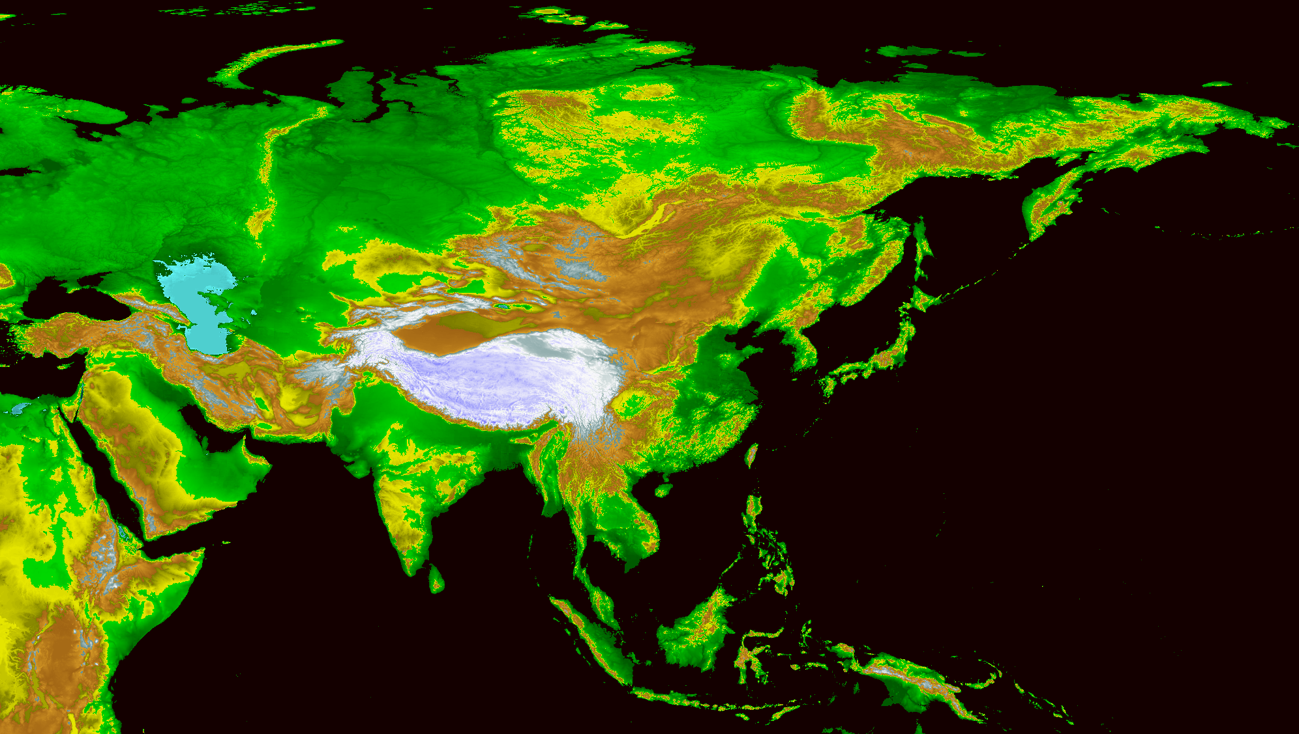

Slide 7
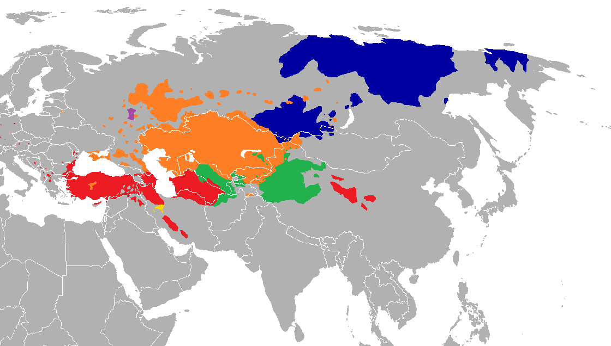

Slide 8
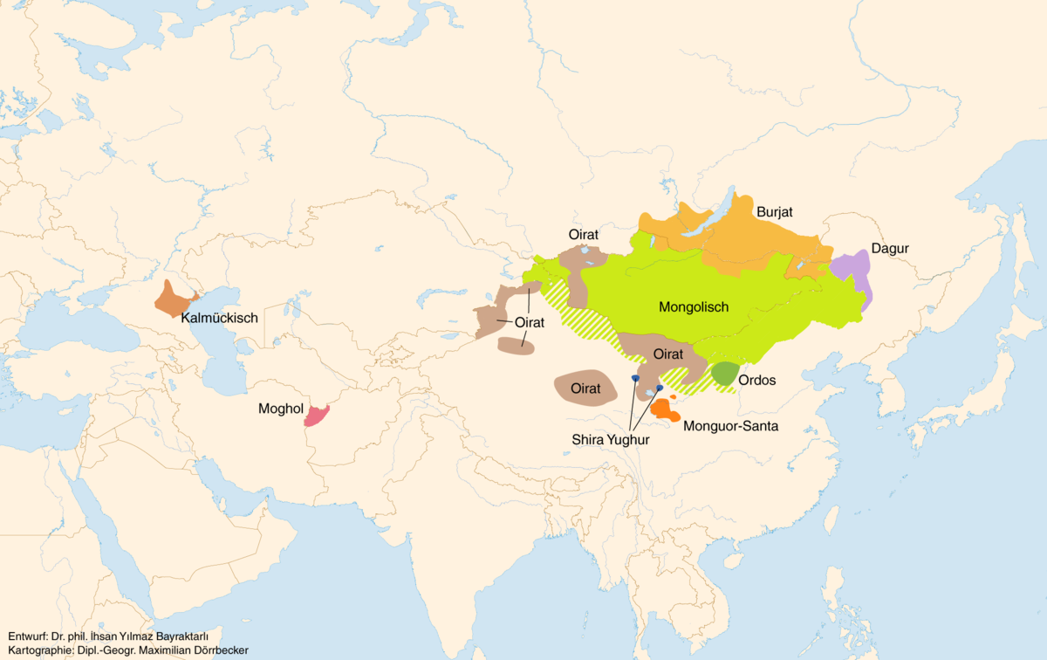
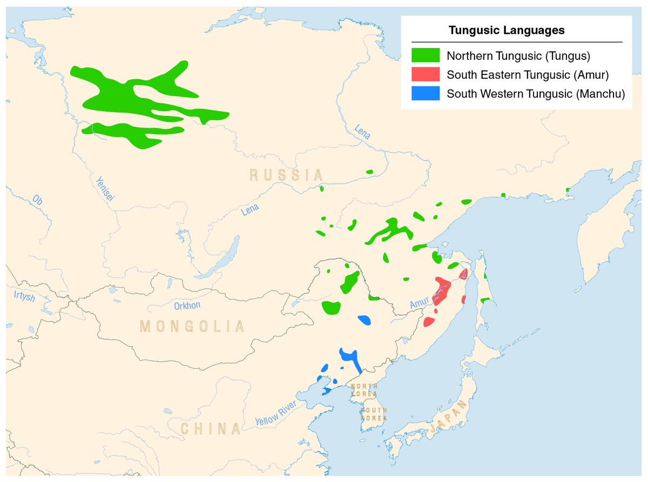

Slide 9
